Slide 1


Care Plan
TEAM NUMBER 2.06
Patient
Primary Oncologist
Referred Healthcare Providers
One-stop Health Schedule Triage System for Primary Oncologists, Patients and Referred Healthcare Providers.
Slide 1

Slide 2

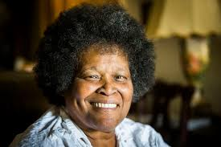

PROBLEM
TEAM NUMBER 2.06
►Mary calls her physician and comes to see the oncologist.
► Too much time has elapsed, Mary immune system is profoundly compromised and she has pneumonia.
► Mary dies a couple days later.
► The week before end of treatment she visits her local ER presenting with shortness of breath thought it was benign.
►Mary is sent home
► Mary, a 64 years old female with stage II cancer patient.
► After twelve treatment cycle the scan showed 95% complete remission.
INCHES MATTER!!
Slide 2

Slide 3




PROBLEM
TEAM NUMBER 2.06
►Cancer patients undergo immunotherapy and are a HIGH risk group (COVID).
►Access to healthcare in rural areas is limited.
►Medical oncologists are more focused on the underlying pathology and treating the cancer.
►Referrals get lost in the system.
►Caregiver burden and depressive symptoms are most common negative outcome for providing care.
Slide 3

Slide 4

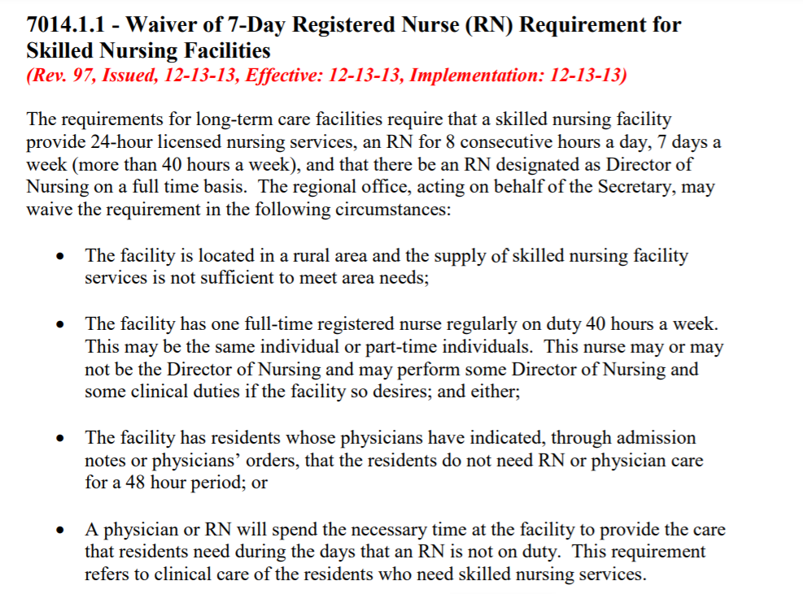
Health at Home Model Reimbursement
TEAM NUMBER 2.06
Nurses need more time to take care of the patients especially in areas where access to healthcare is limited.
Slide 3

Slide 5
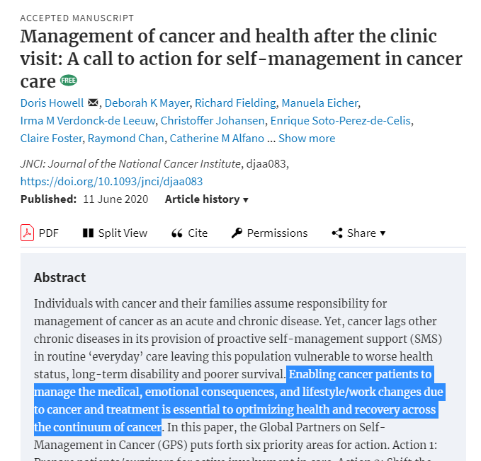
Value Proposition
HOW WILL WE TRACK PROGRESS?
TEAM NUMBER 2.06
The easiest metric is "receipt of survivorship care plan" MOST because most patients don't even get one!!
Slide 4

Slide 6
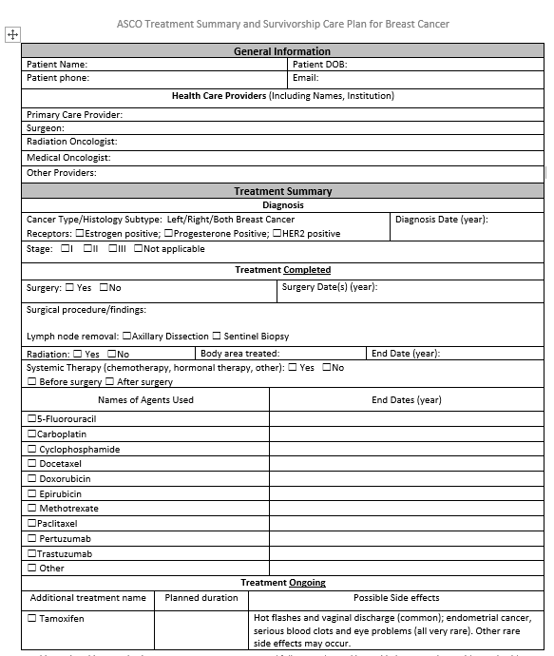

Survivorship Care Plan Tools
TEAM NUMBER 2.06
Slide 5

Slide 7
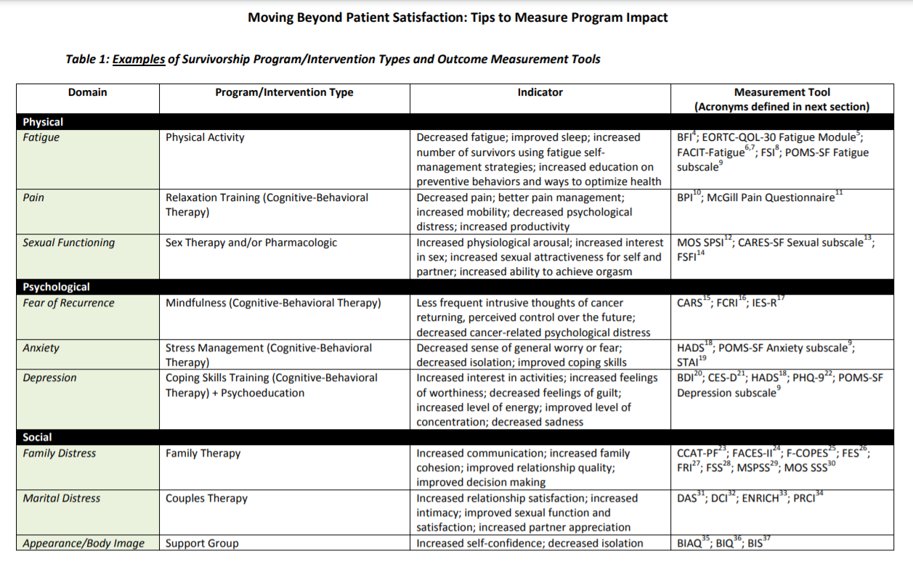

Quality of Survivorship Care Metrics
TEAM NUMBER 2.06
Slide 6

Slide 8

Solution
TEAM NUMBER 2.06
An automated breast cancer survivorship plan that helps patients schedule & keep track of their specialist referrals and follow-ups.
Care Plan
Slide 7

Slide 9
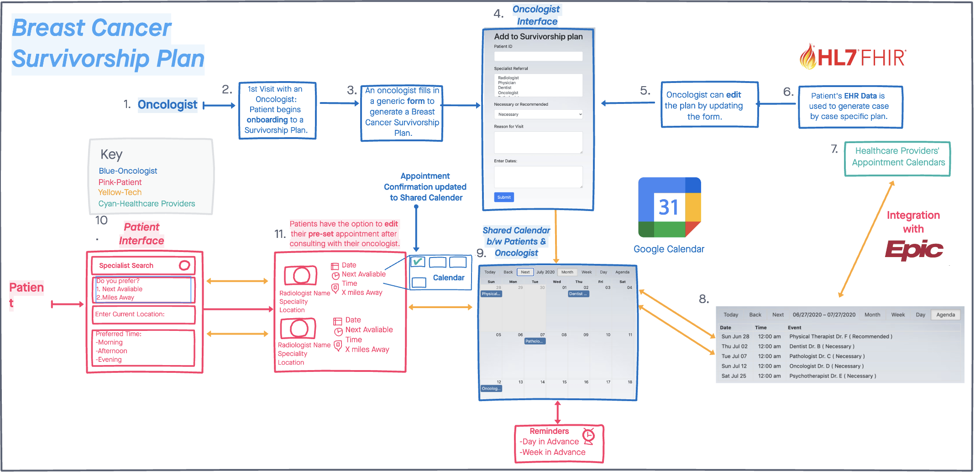


Breast Cancer Health Schedule Triage Workflow
TEAM NUMBER 2.06
Slide 8

Slide 10
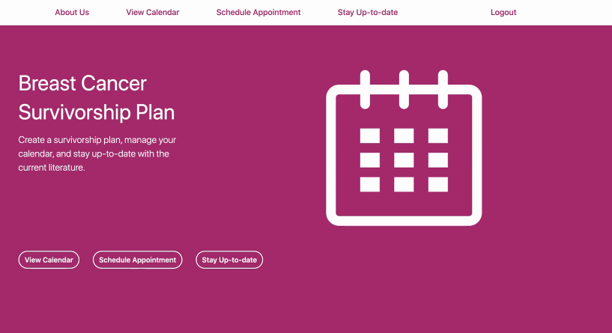
Breast Cancer Plan Template
TEAM NUMBER 2.06
Slide 9

Slide 11

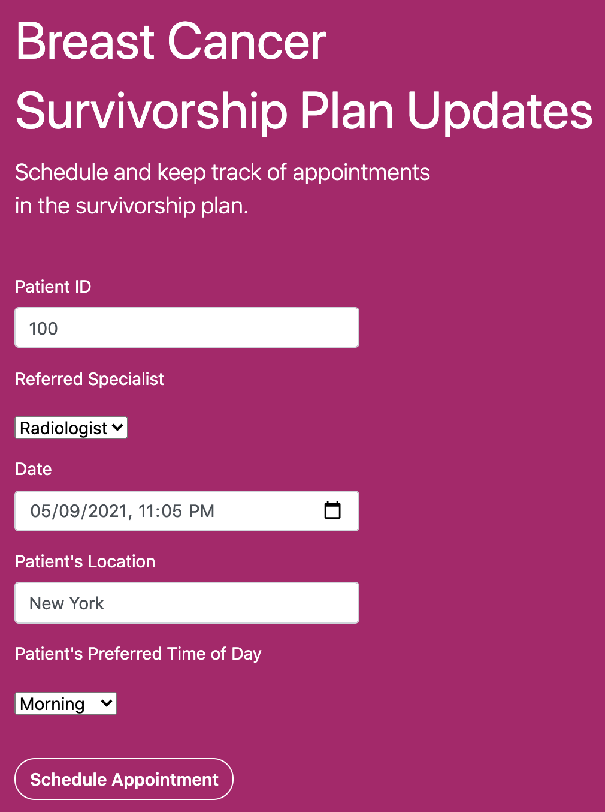
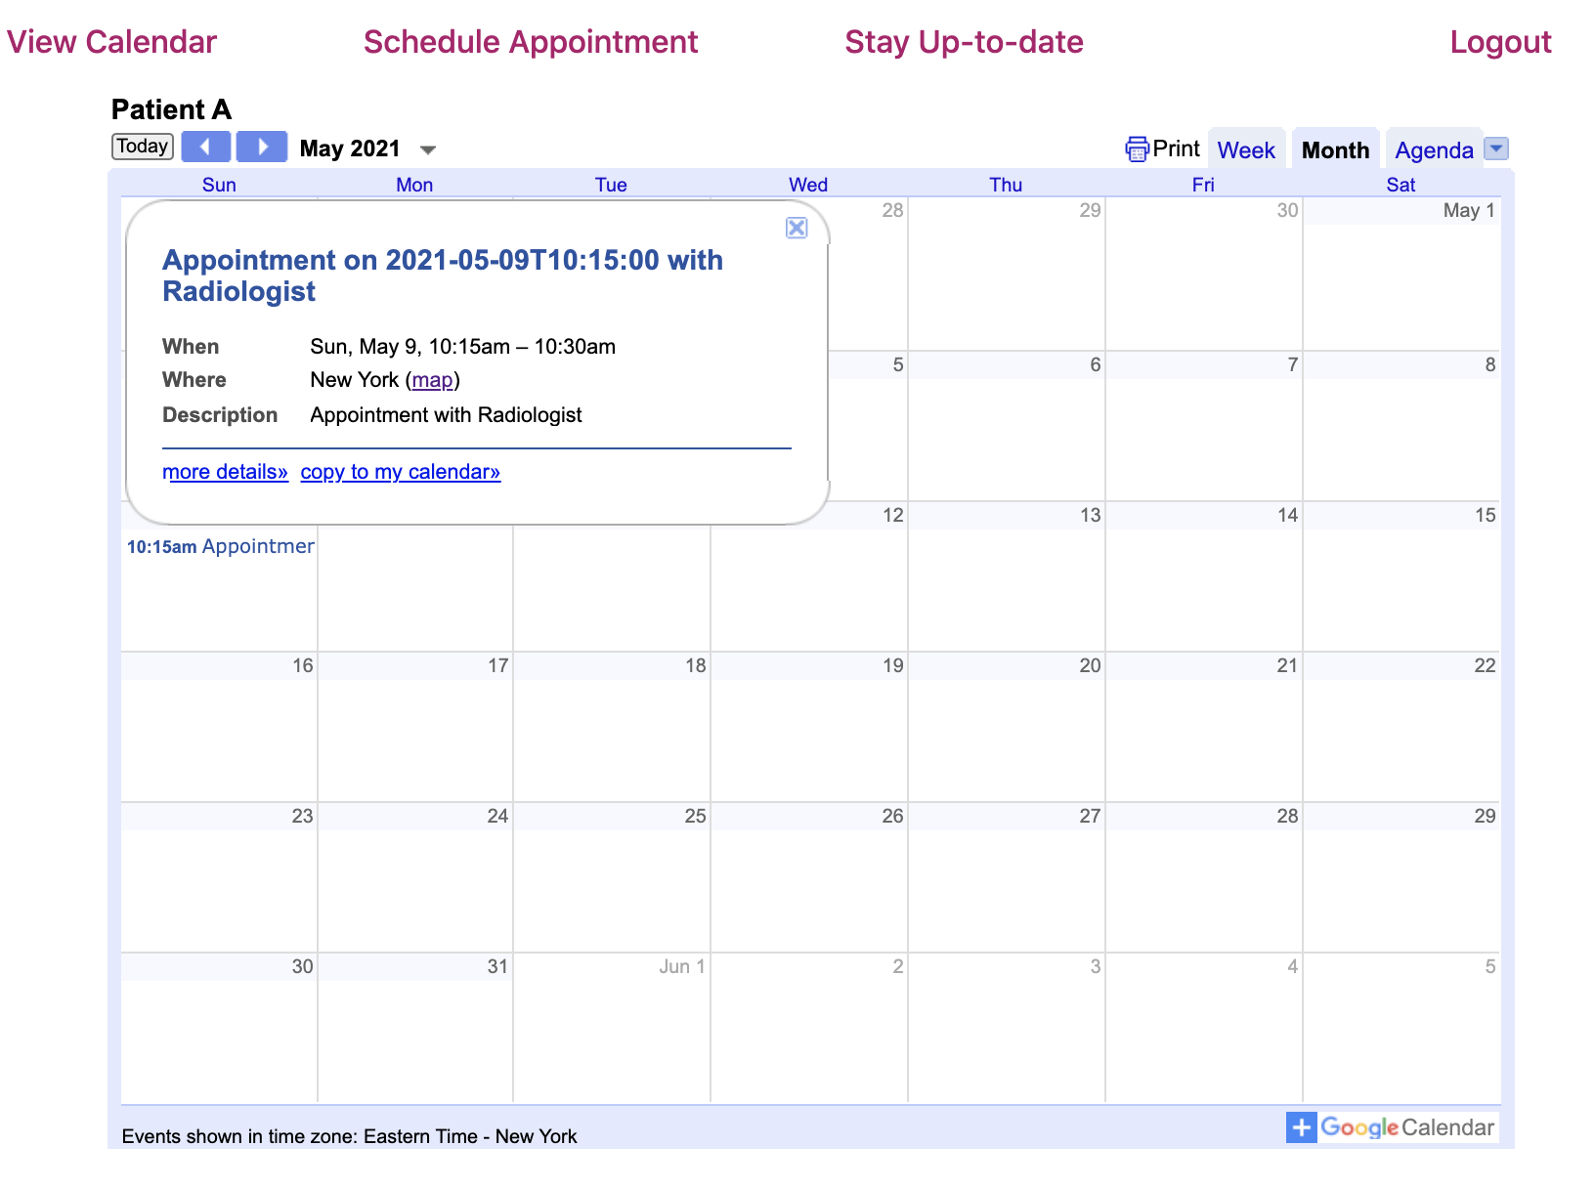



Automated Breast Cancer Plan
TEAM NUMBER 2.06
Primary Oncologist Interface
Shared Calendar
100
Shared Calendar
Slide 10

Slide 12
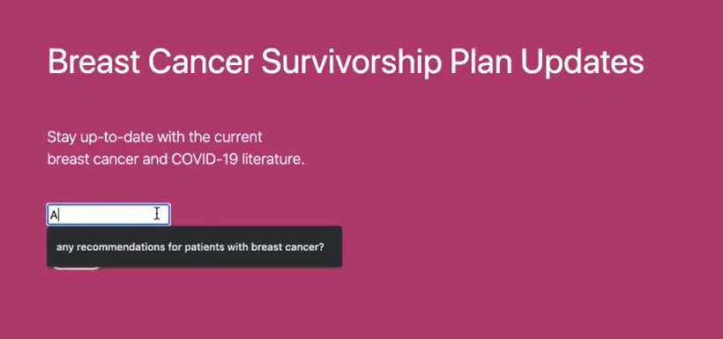

TEAM NUMBER 2.06
Stay Up-to-date with Current Literature
Slide 11

Slide 13

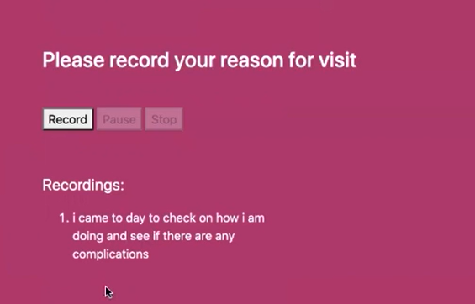
TEAM NUMBER 2.06
Patient-Physician Encounter
Speech Recognition for Patient-Physician Encounter
Slide 12

Slide 14
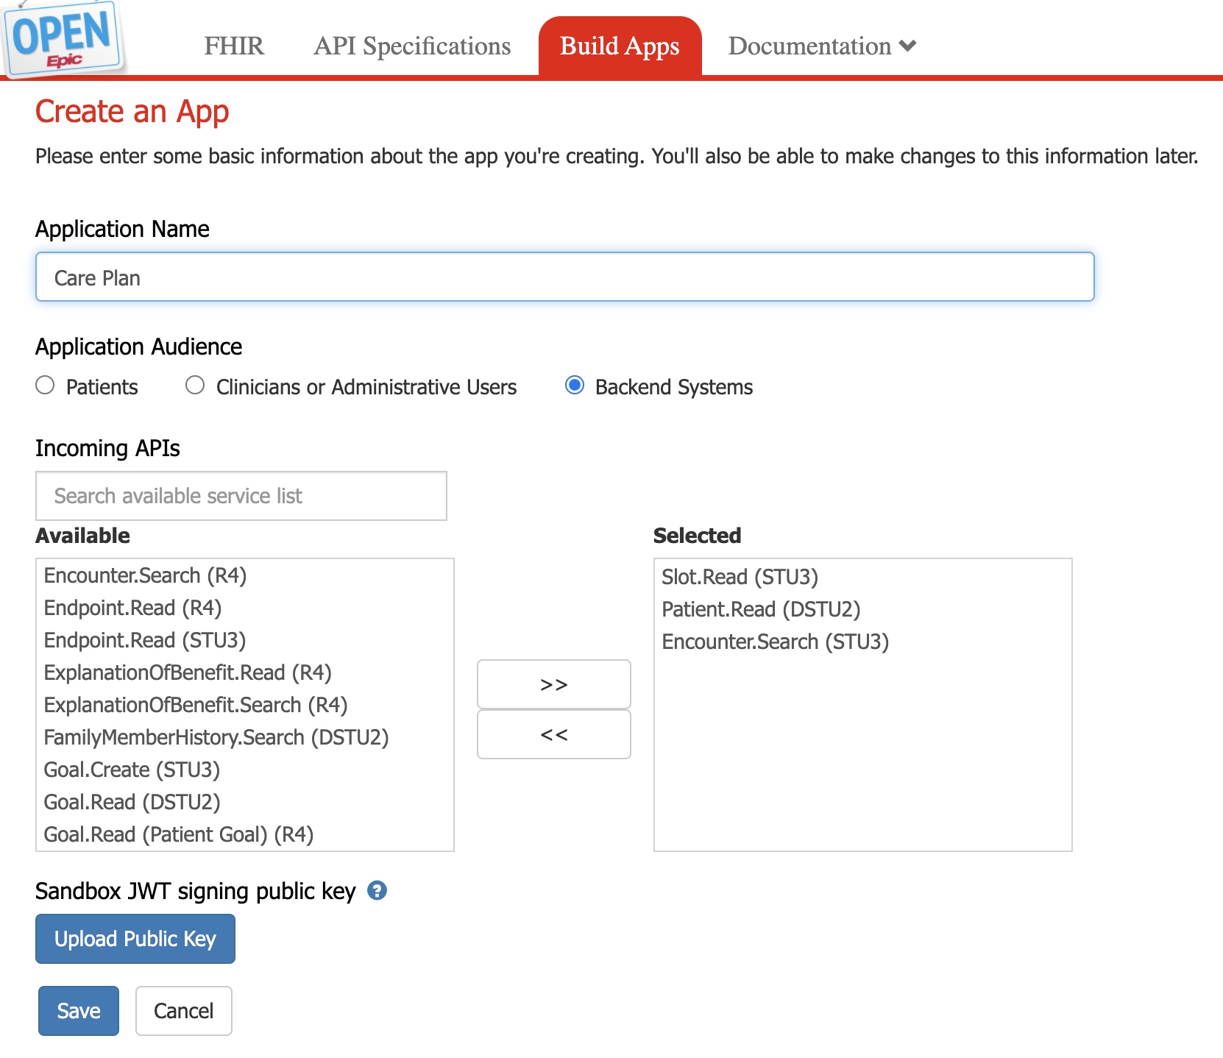
Integrate FHIR into Application using Open.Epic
TEAM NUMBER 2.06
Slide 13

Slide 15
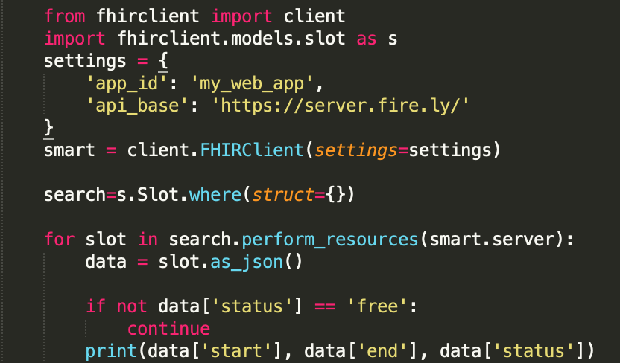

Accessing FHIR Resources
TEAM NUMBER 2.06
Slide 14

Slide 16
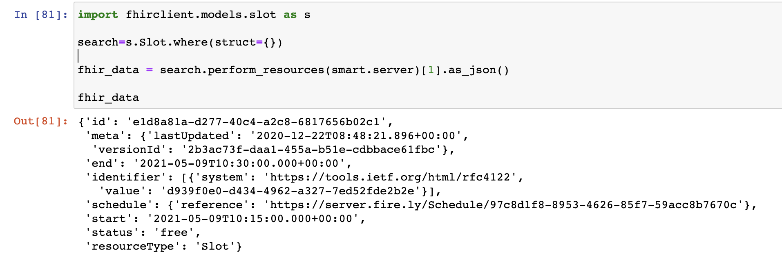
Available Appointment Slot
TEAM NUMBER 2.06
Slide 15

Slide 17


Business Model
B2B
B2C
TEAM NUMBER 2.06
HealthCare Systems
Licensing Access and annual subscription model
$2,500 per year
Initially:
Host of app orchard ( Easy Integration)
Largest Market Share (EPIC)
Patients, or Outpatient Provider Clinics (Consumers)
For the patient community: patients, families, survivors
To share tips and resources with one another
$10 per month
Initially:
Host of app store
Epic Public API integration
Slide 16

Slide 18








Competitive Analysis
TEAM NUMBER 2.06
Company | Breast Cancer Care Plan and Guidelines | Patient Support | Automated Reminders , Triage and One Stop Shop
Breast Cancer Care Plan
NIH and AHRQ eCare Plan
CareVive
UBERDOC
ZocDoc
SurvivorPlan
Slide 17

Slide 19
2021 RoadMap Vision
TEAM NUMBER 2.06
Enterprise Scaling Expansion to different hospital systems.
Ideation and Prototype
Integrating with various partners to access EHR Calendar and Clinical Data
Developing additional Patient and Referral Interface
Step 1
Step 4
Step 2
Step 3
Slide 18

